Slide 1

EXPERT SYSTEM USING
BAYESIAN NEURAL NETWORKS
MTECH PROJECT PRESENTATION
GUIDE: Dr. Srinivas Padmanabhuni
S. BHARATH KUMAR
CS20M011

Slide 2
CONTENTS
ABSTRACT
INTRODUCTION
PROBLEM DEFINITION
TIMELINE AND EXECUTION PLAN
IMPLEMENTATION
CONCLUSION
REFERENCES

Slide 3
Abstract
An Expert System can be defined as a knowledge-base system that acquires knowledge from its knowledge base of a specific domain and addresses user queries using its inference engine about that specific domain.
In the Expert System, we have 3 main parts(knowledge base + inference engine + user interface). It has many applications in various domains.
We are using Bayesian Neural Networks as a part of the inference engine of the expert system which helps to overcome the uncertainties from general Neural Networks and gives confident and dynamic predictions. This yields us better results.

Slide 4
Introduction
Expert system:
It can be defined as a knowledge-based system where it acquires knowledge about a particular(specific and narrow) domain with the help of an expert from that domain and uses its inference engine(here it’s BNN and not rule-based ones) to address user queries.
Expert System = knowledge base + inference engine + UI(optional)

Slide 5
Bayesian Neural Network:
It is defined as a stochastic ANN trained using Bayesian inference. In simple terms, we use the probability of weights and biases and other parameters instead of singular values to the above terms.
BNN = Stochastic Neural Network + Bayesian Inference.
Stochastic Neural Network = ANN + stochastic components(using probability distribution p(θ))

Slide 6
Problem Definition
We are developing an Expert system by using Bayesian Neural Networks as a part of its inference engine.
Why use Bayesian Neural Networks when we can do it with Feed-Forward Neural Networks (General ones), It is because normal Neural Networks fit over the given data and becomes overconfident about their predictions. This causes them to be uncertain.
To overcome this, we are implementing Bayesian Neural Networks for developing an inference engine for our expert system.
These BNN’s predicts with certainty and are dynamic and confident over their predictions. They achieve it by using probabilities for weights and biases instead of only integers.

Slide 7
Timeline and Execution Plan
The overall timeline and the execution of the project.
3rd Semester End Term: Developing a Bayesian Neural Network.
4th Semester Midterm: Different variations of BNN’s developed for Expert System.
4th Semester Final evaluation: Full Project and Final Report to be submitted by the end of the 4th Semester. (Mtech 2nd year)

Slide 8
Implementation
Dataset: AI4I 2020 Predictive Maintenance Dataset from UCI Repository (link here).
Google Colab Notebook: link here.
Pre-processing data.(Product Quality: L,M,H -> 1,2,0)
Training(70%) and testing data(30%).
Compile, train and evaluating the models.
Standard Neural Network (using tensorflow)
Bayesian Neural Network (using tensorflow-probability)

Slide 9
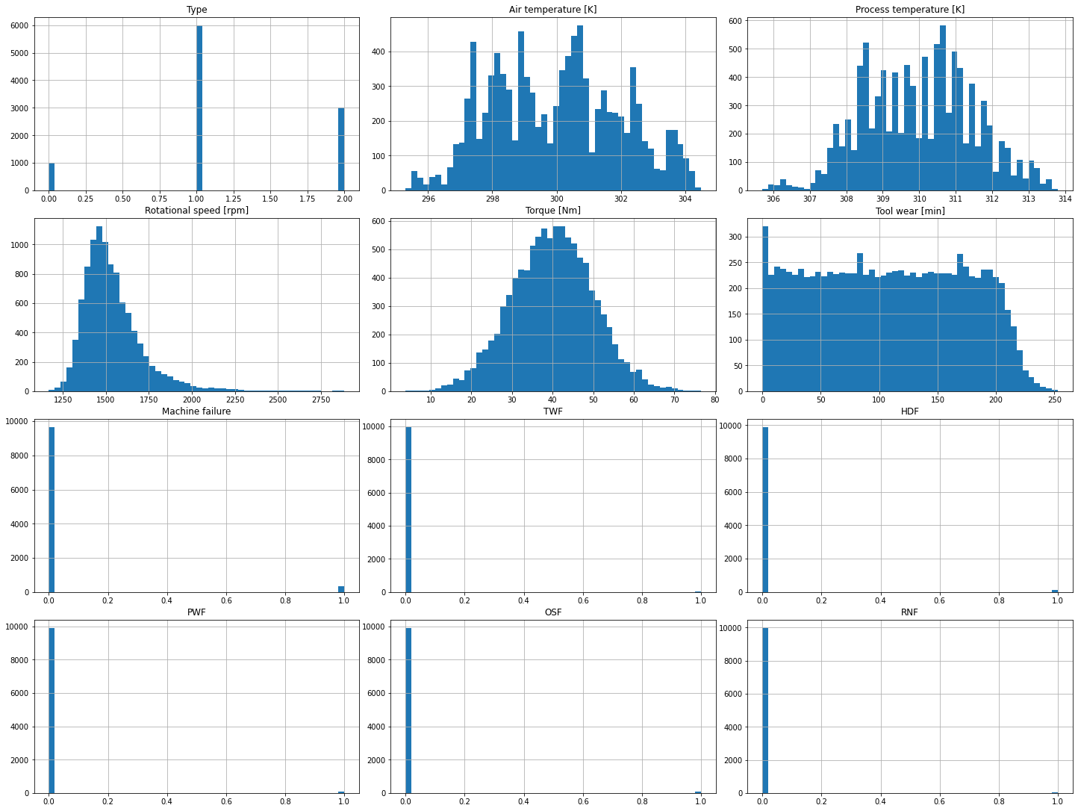

Slide 10
Standard Neural Network
Standard Neural Network: Implemented using tensorflow library by creating a neural network of 3 layers (Input, hidden and output layer).
No of epochs: 50
Learning rate: 0.001
Train accuracy: 0.9649
Training loss: 0.1522
Test accuracy: 0.9690
Test loss: 0.1385

Slide 11
Bayesian Neural Network (BNN)
Bayesian Neural Network (BNN): Implemented using tensorflow-probability library by creating a neural network of 3 layers (Input, hidden and output layer).
No of epochs: 50
Learning rate: 0.001
Training accuracy: 0.9690
Training loss: 0.4488
Test accuracy: 0.9686
Test loss: 0.4487

Slide 12
Conclusion
The main advantages of Expert systems using BNN’s are that
An Expert System with better performance and confident predictions.
Useful for experts in decision making and applicable across various other domains.
The main disadvantages of Expert systems using BNN’s are that
Domain expertise availability.
Extract and upgradation of knowledge from expert.
high complexity.
Expert system has many advantages compared to its limitations. So to overcome its limitations, we can use various practical implementation techniques of Bayesian neural networks as a part of its inference engine which approximates them yet gives better results.

Slide 13
References
Dataset: D. Dua and C. Graff, “UCI machine learning repository,” 2017. [Online].
Available: http://archive.ics.uci.edu/ml
L. V. Jospin, W. Buntine, F. Boussaid, H. Laga, and M. Bennamoun, “Hands-on bayesian neural networks – a tutorial for deep learning users,” 2020.
K. Bykov, M. M.-C. H¨ohne, A. Creosteanu, K.-R. M¨uller, F. Klauschen, S. Nakajima, and M. Kloft, “Explaining bayesian neural networks,” 2021.
D. T. Chang, “Bayesian neural networks: Essentials,” arXiv, 2021.
N. Hassen and I. Rish, “Approximate bayesian optimisation for neural networks,” arXiv, 2021

Slide 14
PHASE -2 (4TH SEMESTER)

Slide 15
CONTENTS
Visualizing BNN
Variants of BNN
Variational Inference
Monte Carlo - Dropout
Early Stopping
Comparison of Different Models
Web Application for Expert System

Slide 16
PLAN(STAGES OR STEPS)
1. VISUALIZE BNN
2. VARIANTS OF BNN
3. SELECT THE BEST VERSION OF IT
4. GUI FOR EXPERT SYSTEM
5. INPUTS OF VARIOUS FIELDS TO THE SYSTEM TO GIVE INPUT TO MODEL.
6. RESULT FROM MODEL OF 0 AND 1 IS TO CONVERTED INTO TEXT TO BE ABLE TO UNDERSTOOD BY THE USER.
7. FINAL REPORT
8. FINAL PPT FOR PRESENTATION
9. PREPARE FROM MY DL BOOK FOR MTP PRESENTATION AND VIVA.
10. DONE!!!!!

Slide 17
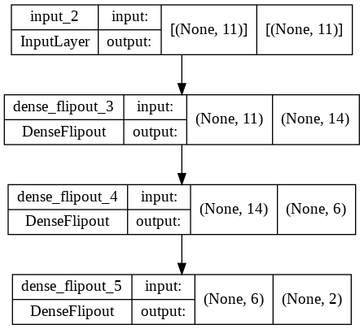
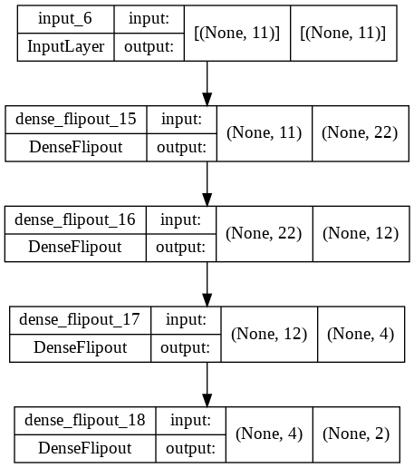
Visualize BNN

Slide 18
Variants of BNN
VI.(VARIATIONAL INFERENCE)
Variational Inference is also known as a posterior distribution over the latent variables and it can be defined as the conditional distribution over the latent variables given the observations and parameters.

Slide 19
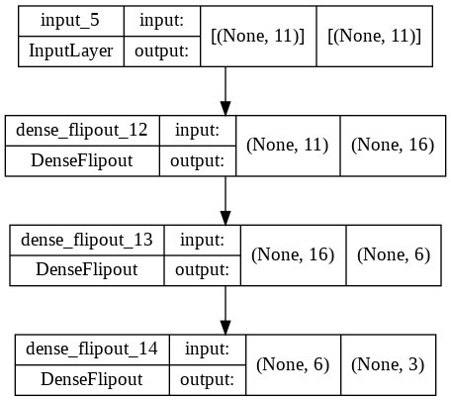
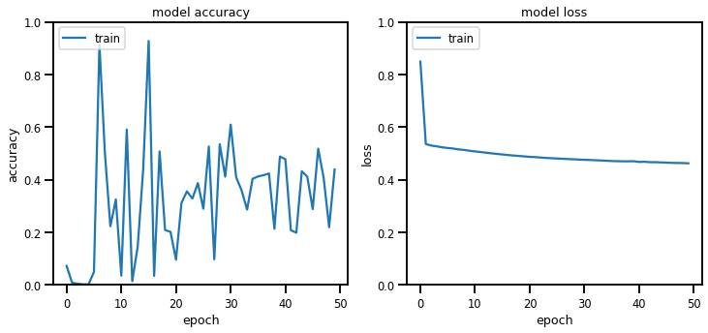
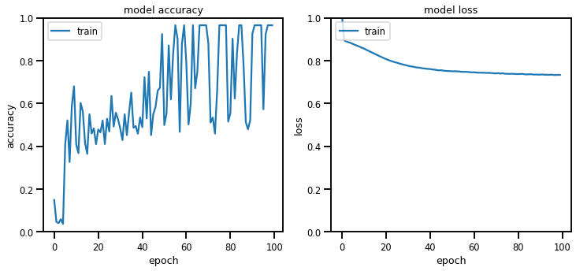

Slide 20
Variants of BNN
MC VIA DROPOUT
Monte Carlo Dropout is an improvement of the regular dropout (in which different neurons are dropped) technique which can be interpreted as a Bayesian approximation of a probabilistic model in which we consider many different neural networks as Monte-Carlo samples out of all models which are available. In most cases, it improves the performance of the model.
Parameter to be passed: Probability value which indicates the number of neurons to be dropped in the network.
Built three models:
Dropout 1 : dropout value = 0.2
Dropout 2 : dropout value = 0.35
Dropout 3 : dropout value = 0.5

Slide 21
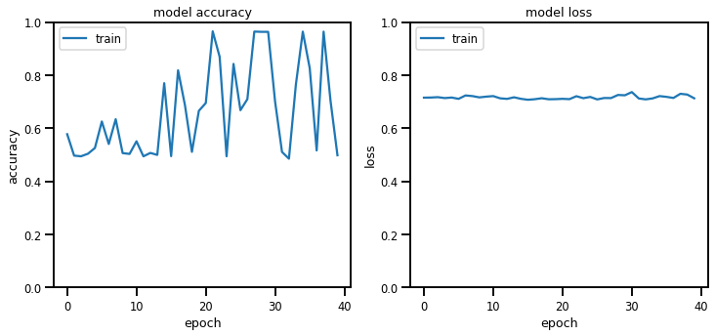
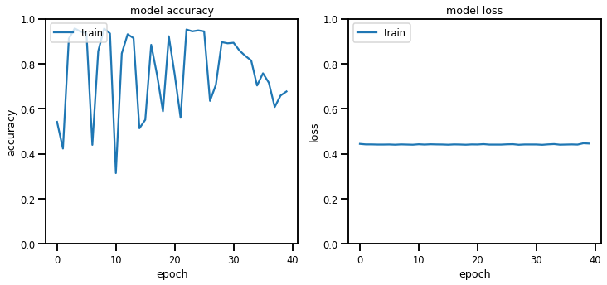
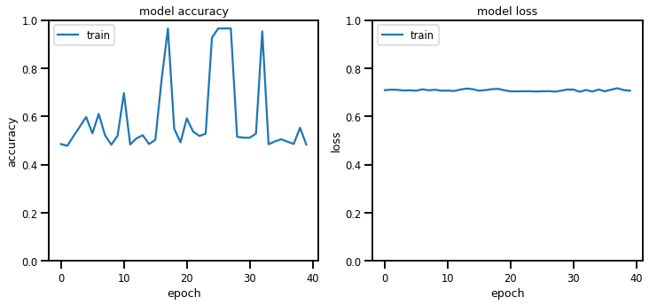
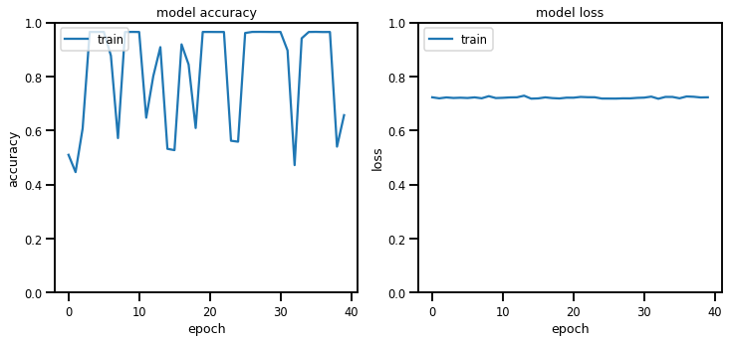
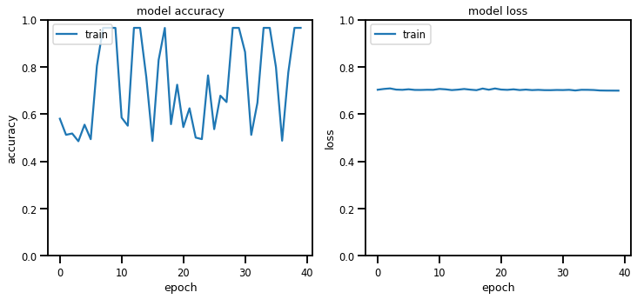
1. Normal BNN -1
2. Normal BNN -2
3. Dropout -1
4. Dropout -2
5. Dropout -3 3.
1.
4.
2. 5.

Slide 22
Variants of BNN
EARLY STOP
It can be defined as stopping the training of a neural network when a monitored value has not improved for a certain number of iterations. This usually improves the performance of the model.
patience: It is the limit on the number of epochs with no improvement. After reaching this count or limit, the training of the model will be stopped irrespective of the total epochs mentioned.
monitor: It describes the quantity(here it is loss which is being monitored.) which is to be monitored during the training of the model.
Built 3 models:
Early Stop 1: patience = 3
Early Stop 2: patience = 4
Early Stop 3: patience = 2

Slide 23
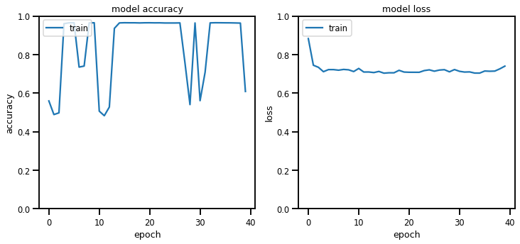
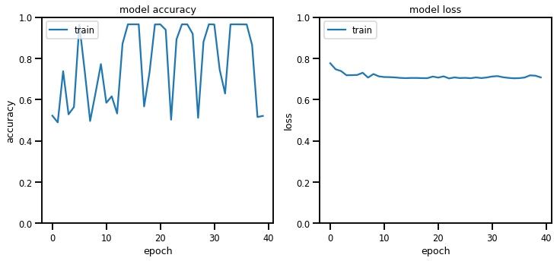
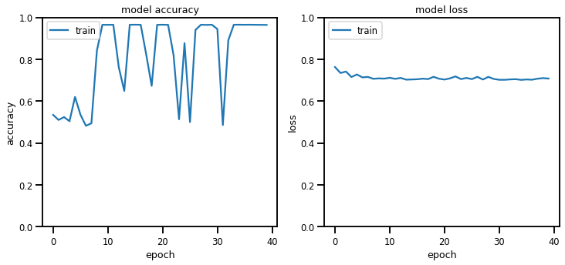
1. Normal BNN -1
2. Normal BNN -2
3. Early Stop -1
4. Early Stop -2 3.
5. Early Stop -3
1.
4.
2. 5.

Slide 24
Comparison of Different Models
Normal vs Dropout:
Normal BNN -1 : loss: 0.4377 - accuracy: 0.9687
Normal BNN -2 : loss: 0.7227 - accuracy: 0.9693
Dropout -1 : loss: 0.7029 - accuracy: 0.9690
Dropout -2 : loss: 0.7039 - accuracy: 0.0313
Dropout -3 : loss: 0.7060 - accuracy: 0.9687
Normal vs Early Stop:
Normal BNN -1 : loss: 0.4379 - accuracy: 0.9687
Normal BNN -2 : loss: 0.7183 - accuracy: 0.9690
Early Stop -1: loss: 0.7300 - accuracy: 0.9673
Early Stop -2: loss: 0.7086 - accuracy: 0.9680
Early Stop -3: loss: 0.7239 - accuracy: 0.9657

Slide 25
Streamlit based Web Application for Expert System - Screenshots

Slide 26
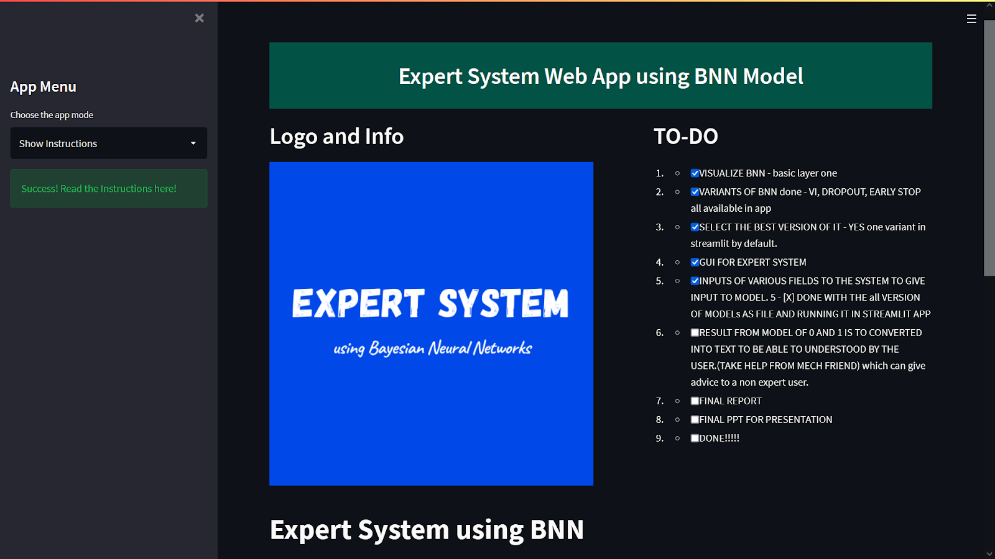
GUI for Expert System

Slide 27
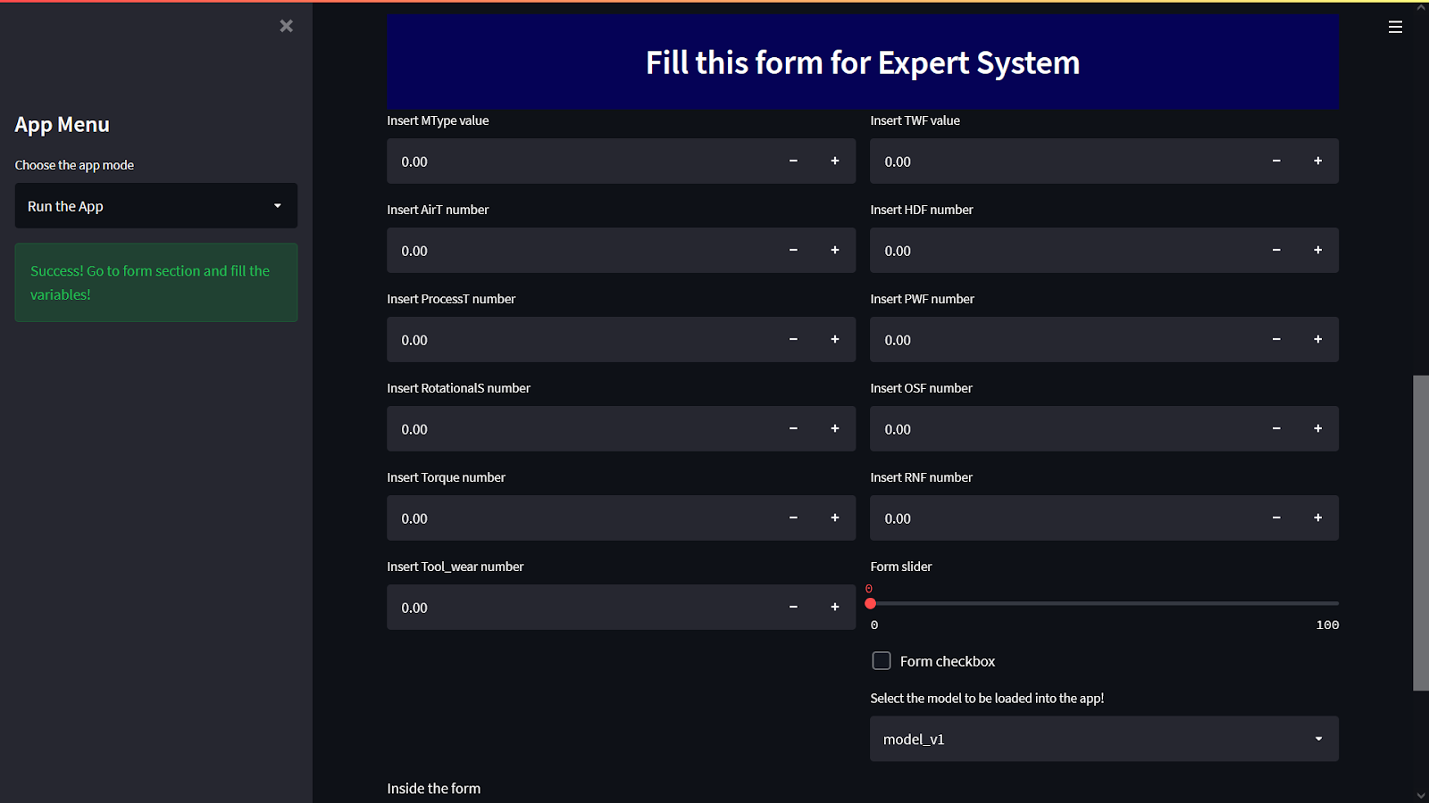

Slide 28
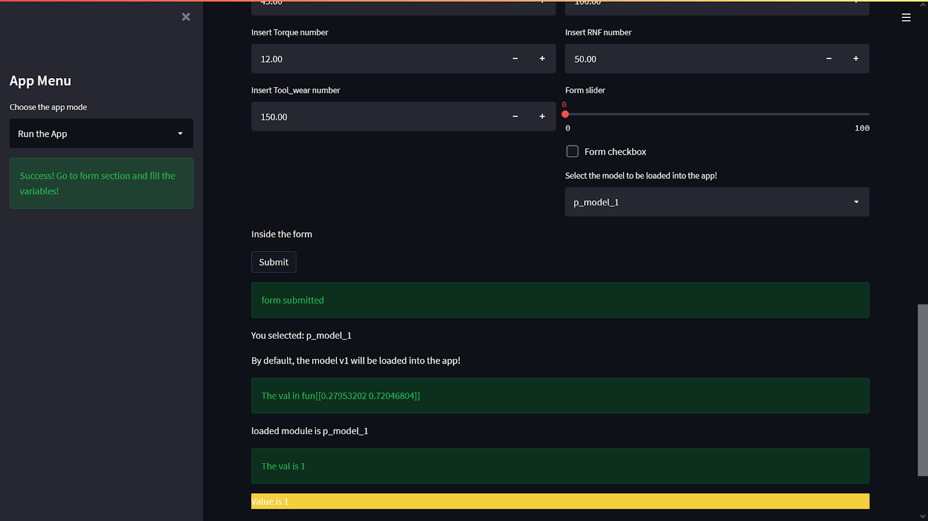
Prediction

Slide 29
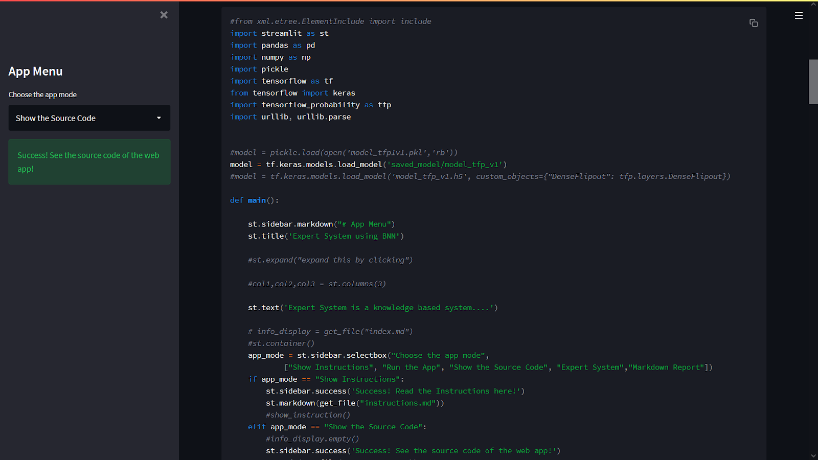
App displaying the source code of the application

